Slide 1
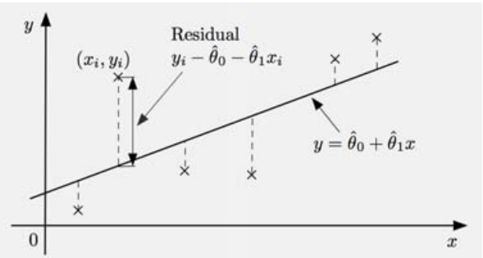
Regression

Slide 2

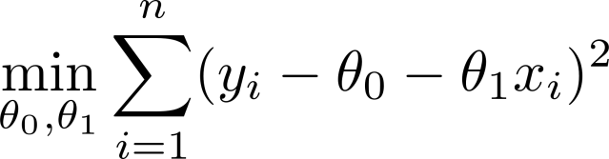

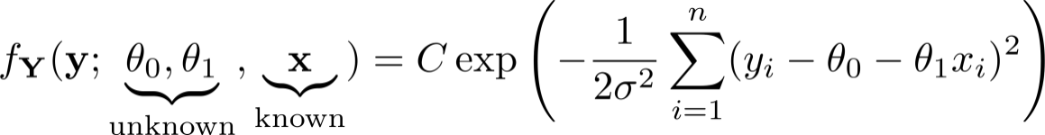
Regression Cont’
Data:
Model:
Statistical interpretation: straight line
model with i.i.d. Gaussian noise
Likelihood function
Taking logs yields “least-squares”
LS criterion comes out of
Common sense
Gaussian noise assumption

Slide 3
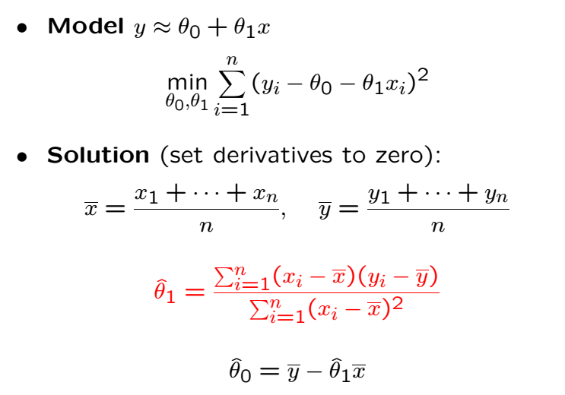
Linear Regression

Slide 5
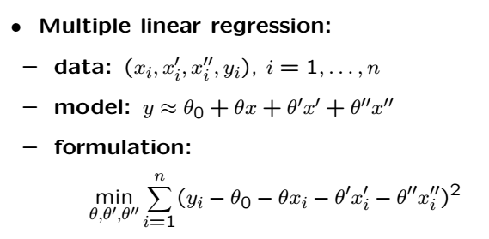

Variations on Regression
Minimization also wrt $θ_{0}$

Slide 6
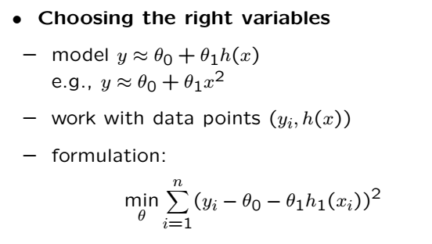
Variations on Regression Cont’
Another option is to take log of the x data (and sometimes y data)

Slide 7
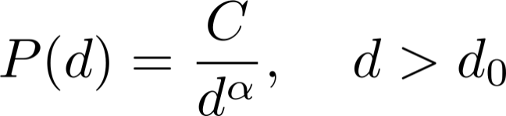
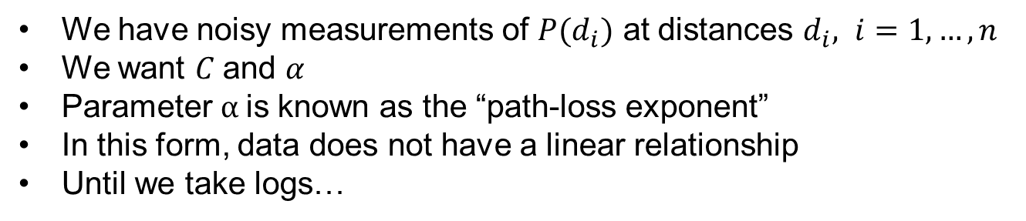
Estimating Power Law Parameters
In wireless comms, the received power
We have noisy measurements of $P(d_{i})$ at distances $d_{i}, i=1,…, n$
We want $C$and $α$
Parameter $α$is known as the “path-loss exponent”
In this form, data does not have a linear relationship
Until we take logs…

Slide 9
Acknowledgements and Citations
Parts of these slides are adapted from the following resources:
Power Point Lecture Slides for the Textbook http://bcs.wiley.com/hebcs/Books?action=index&bcsId=8676&itemId=1118324560
John Tsitsiklis. 6.041 Probabilistic Systems Analysis and Applied Probability, Fall 2010. (Massachusetts Institute of Technology: MIT OpenCourseWare),http://ocw.mit.edu (Accessed 13 Apr, 2015). License: Creative Commons BY-NC-SA

